Slide 1
7FNCE040W
Business Analytics
WEEK 3 Bite 1

Slide 2
Supervised versus unsupervised learning
1. supervised learning for each observation of the predictor measurement x, There is an associated measurement y. Aim is to accurately fit a model that ‘predicts’ for future observations (prediction) or for better understanding the relationship between the response and the predictor ’Inference’. E.g Linear regression , logistic etc
2. Unsupervised learning. More challenging in which each observation I we have a vector measurement XI but no associated response y. not possible to fit a linear regression model or no response by variable to predict. i.e We lack a response variable that can supervise our analysis. E.g. Cluster analysis aim is to see if based on variables x fall into ‘groups’ clusters.
Note there are situations ‘semi-supervised learning problems’

Slide 3
Variables can be classified as Quantitative or Qualitative
Quantitative variables (numerical values )Problems or considered as regression problem. (E.g. Least square Linear regression)
Qualitative responses are often referred to as classification problems ( e.g. Logistic regression predicting class probabilities)
Note the distinction is not always that simple. K-nearest neighbour and Boosting can be used in either case

Slide 4
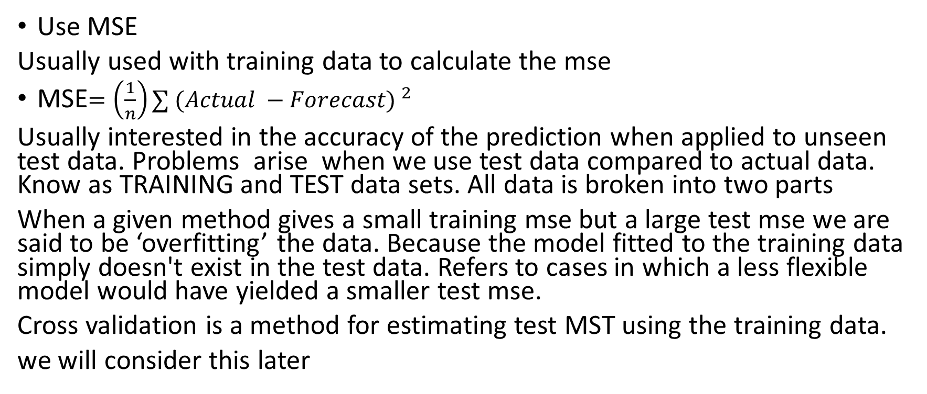
Measuring the Quality of Fit
Use MSE
Usually used with training data to calculate the mse
MSE$=\left(\frac{1}{n}\right)∑{ (Actual −Forecast) }^{2}$
Usually interested in the accuracy of the prediction when applied to unseen test data. Problems arise when we use test data compared to actual data. Know as TRAINING and TEST data sets. All data is broken into two parts
When a given method gives a small training mse but a large test mse we are said to be ‘overfitting’ the data. Because the model fitted to the training data simply doesn't exist in the test data. Refers to cases in which a less flexible model would have yielded a smaller test mse.
Cross validation is a method for estimating test MST using the training data.
we will consider this later

Slide 5
Variance - Bias Trade offs.
Variance refers to the amount by which forecasted value would change if we estimated this by using a different training data set .
Ideally the estimate for Y should not vary too much between training sets however if the method has a high variance then small changes in training data can result in high changes in the forecasted y.
In general more flexible methods have higher variance.

Slide 6
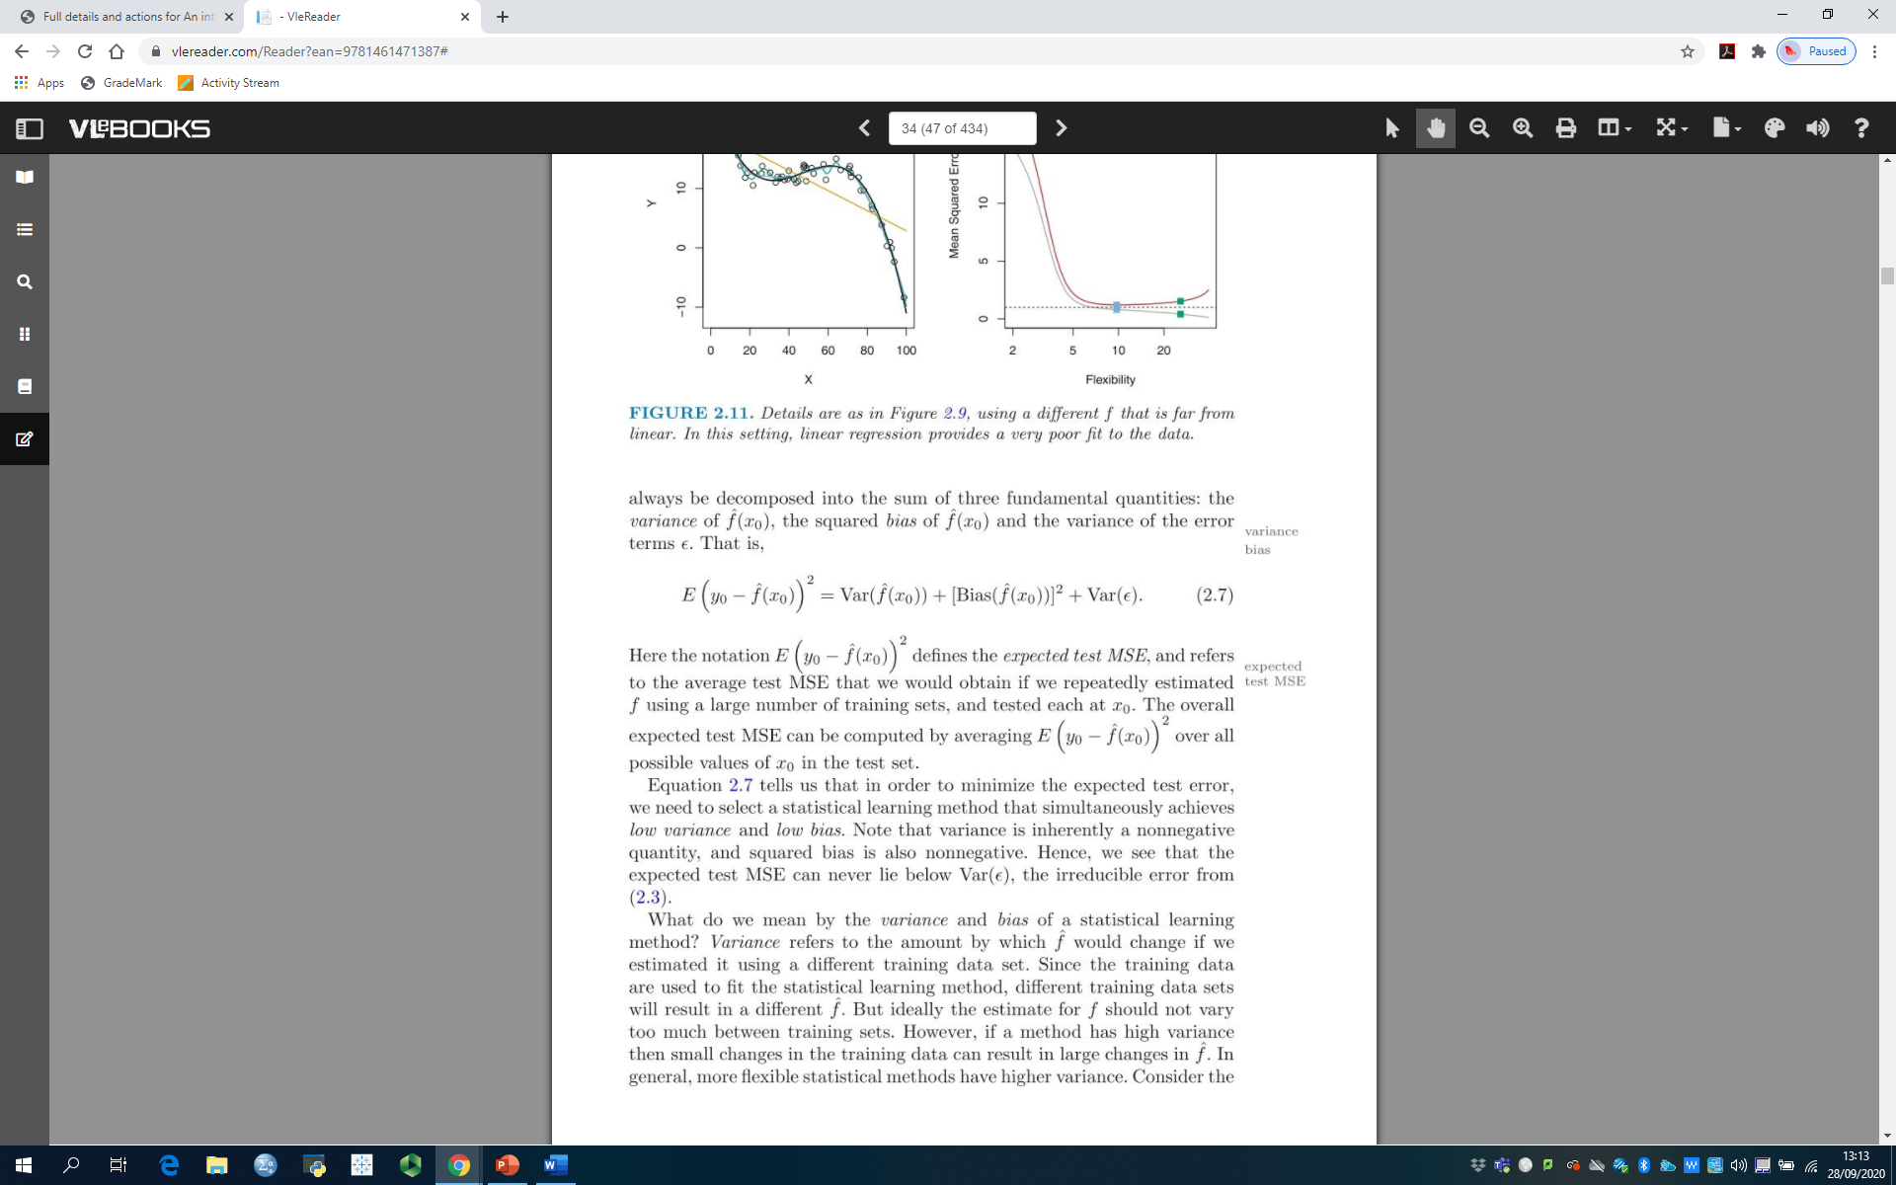
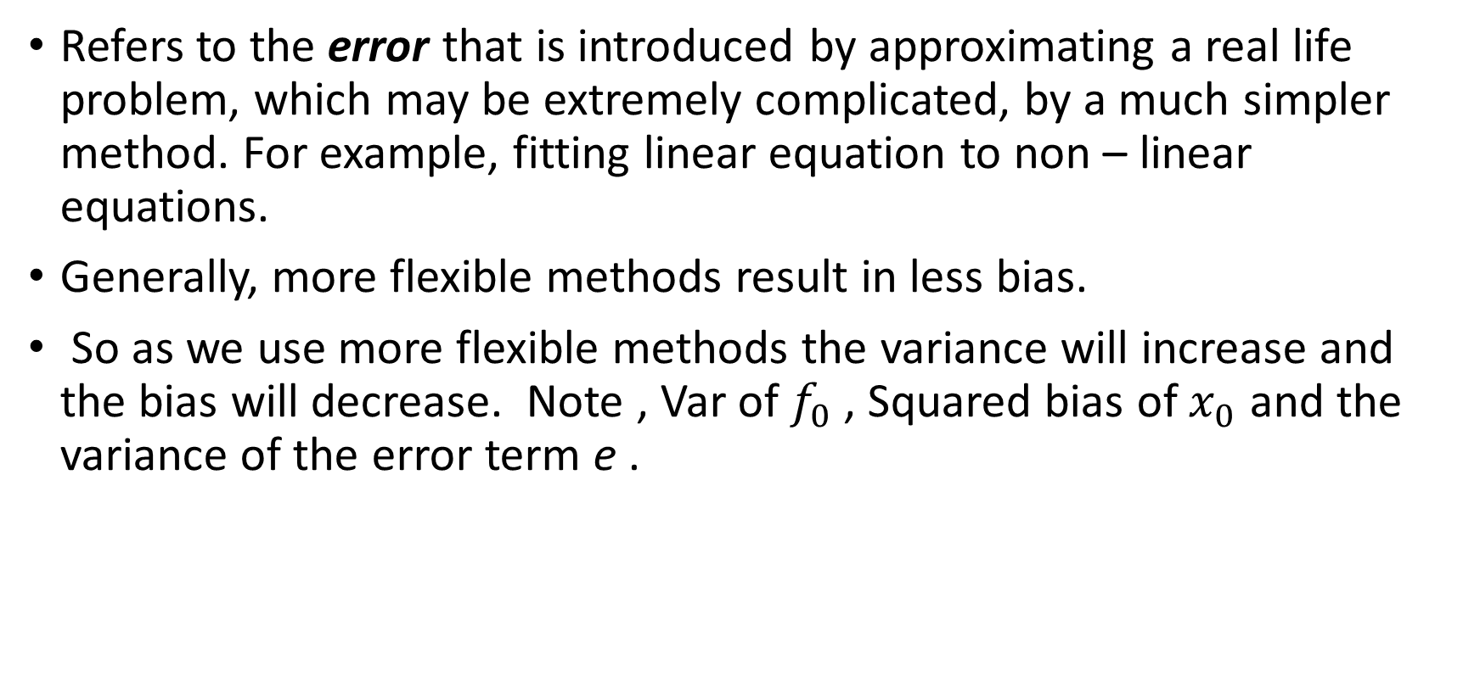
Bias
Refers to the error that is introduced by approximating a real life problem, which may be extremely complicated, by a much simpler method. For example, fitting linear equation to non – linear equations.
Generally, more flexible methods result in less bias.
So as we use more flexible methods the variance will increase and the bias will decrease. Note , Var of $f_{0}$ , Squared bias of $x_{0}$ and the variance of the error term e .

Slide 7
These diagrams refer to the data in the text book -chapter 2. Squared bias = Blue ; Variance = Orange; Var error= dashed line; MSE = Red curve Note the vertical dotted line refers to the flexibility level corresponding to the smallest MSE. NOTE In Reality its not possible to explicitly compute test MSE, Bias, or Variance for any statistical method.

Slide 8
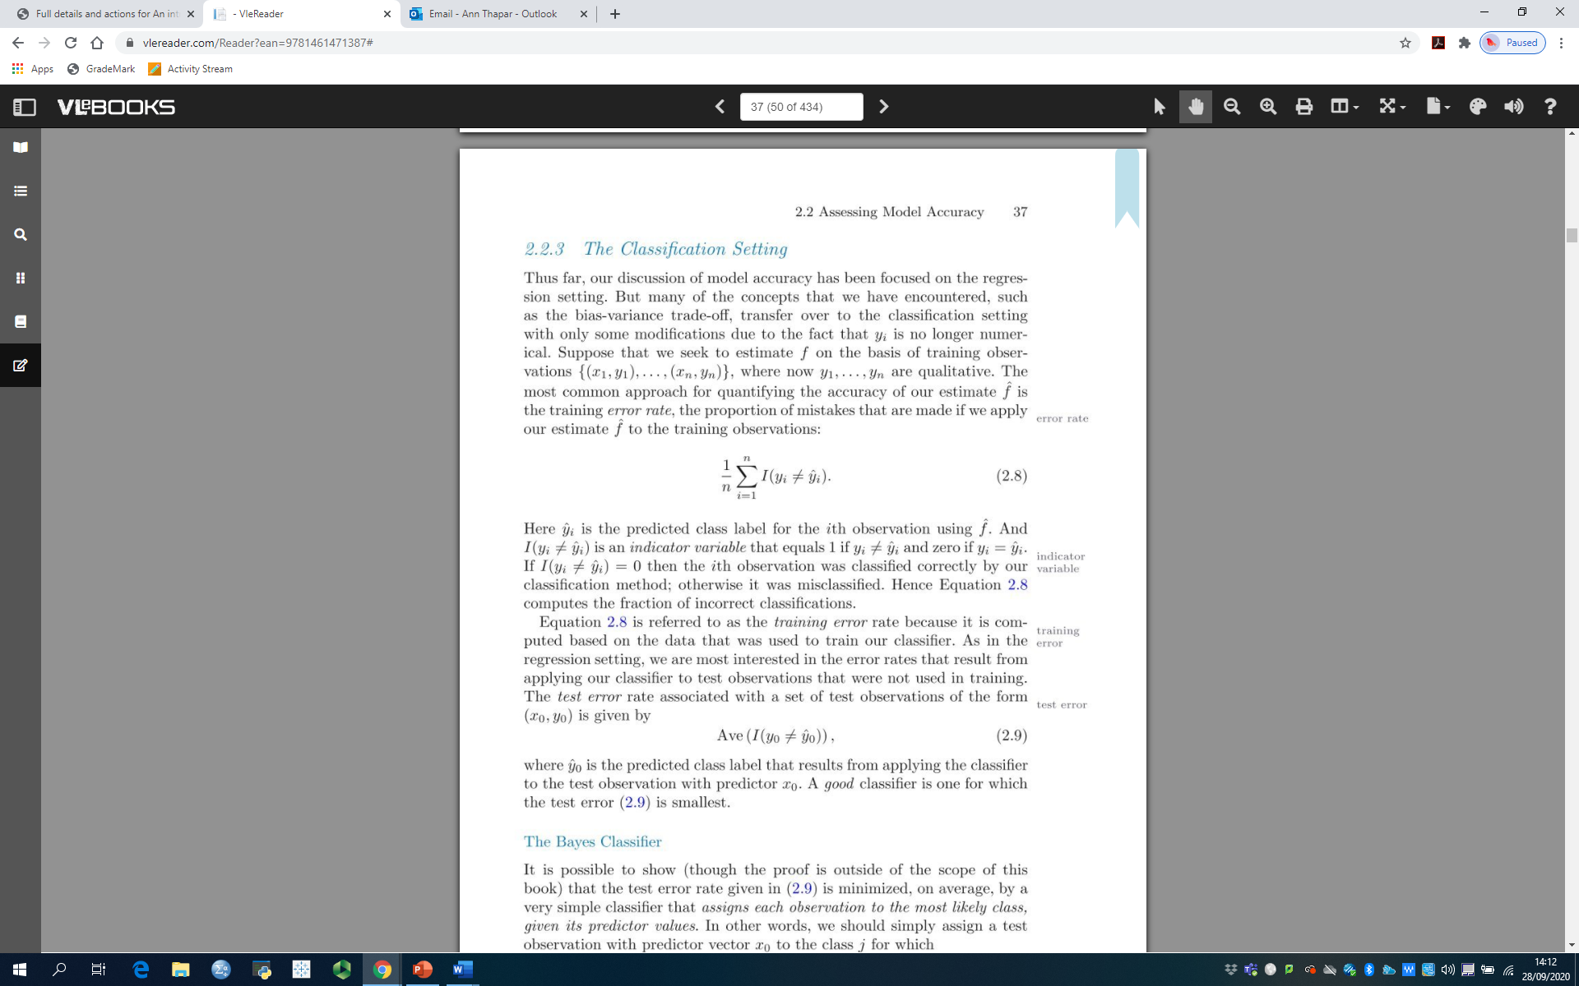
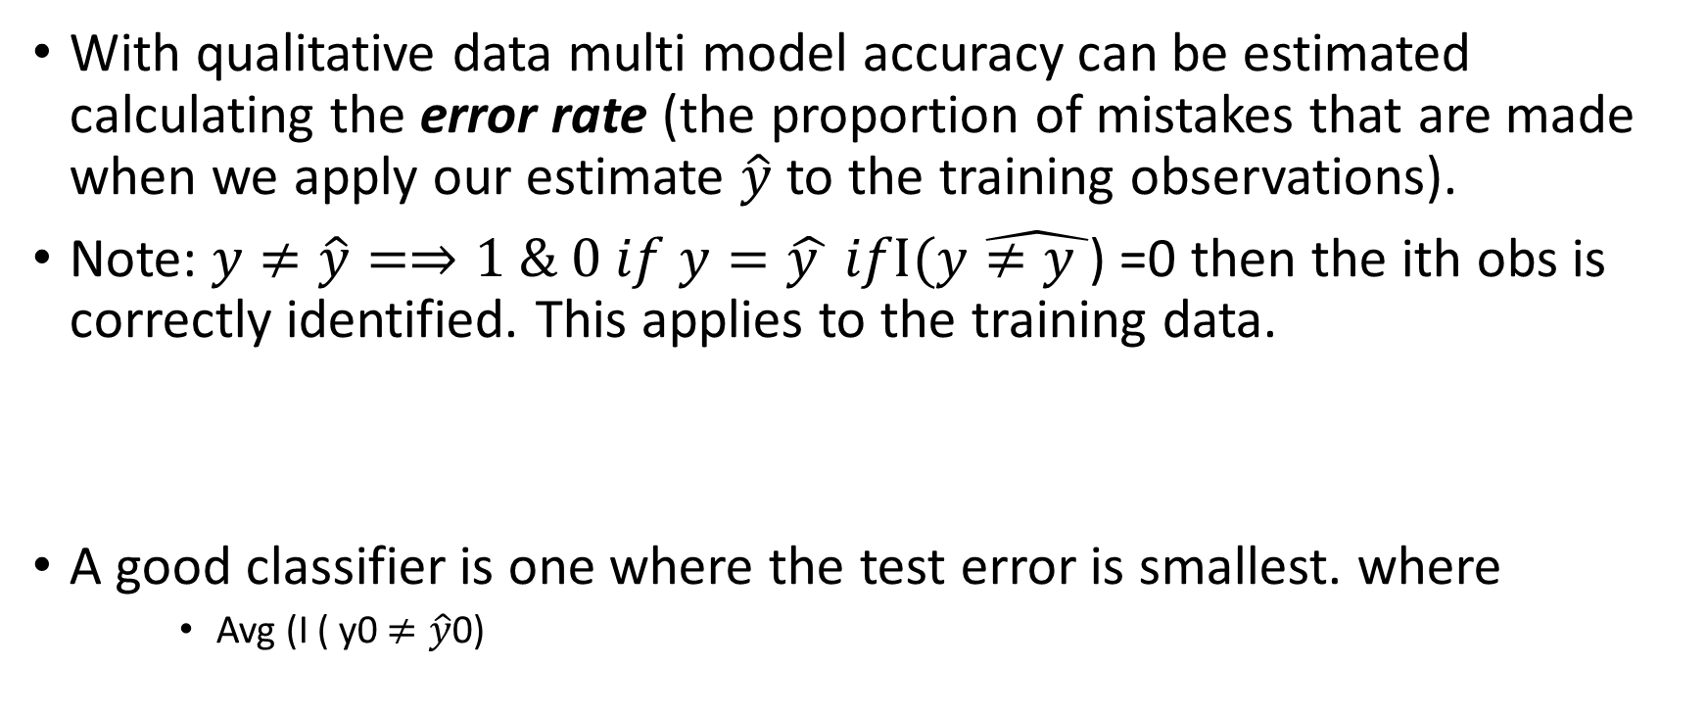
Classification Setting
With qualitative data multi model accuracy can be estimated calculating the error rate (the proportion of mistakes that are made when we apply our estimate $\hat{y}$ to the training observations).
Note: $y≠\hat{y}=⇒1 \& 0 if y=\hat{y }$ $ifI(y\hat{≠y }$) =0 then the ith obs is correctly identified. This applies to the training data.
A good classifier is one where the test error is smallest. where
Avg (I ( y0 $≠\hat{y}$0)

Slide 9
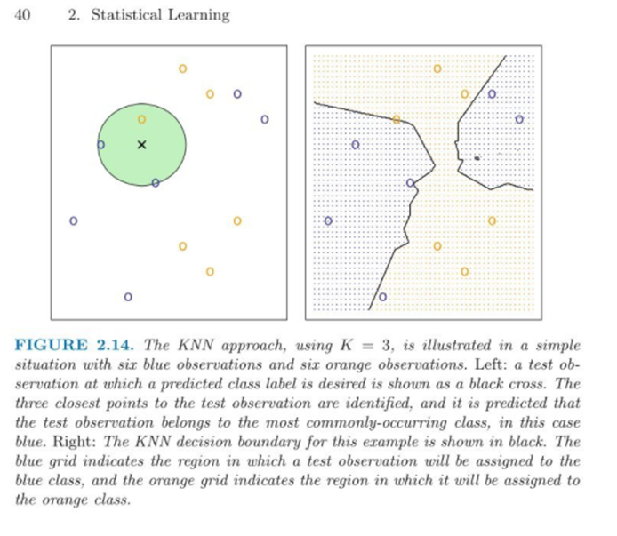
Bayes rule applied to classify test observations. We shall visit this topic later in the module.

Slide 10
Summary
In both the regression and classification setting, choosing the correct level of flexibility is critical to the success of any statistical learning method.
We will return to this topic.

Slide 11
7FNCE040W
Business Analytics
WEEK 3 BITE 2 Simple & Multiple Regression Models revisited

Slide 12
Using SPSS to Build Models
Recall the ‘Advertising’ Data from last week.
As Business Consultants you are asked to suggest a Marketing Plan to increase sales for next year based on the data provided.
You are provided with the following variables : Sales (000’s units) ; Advertising Budgets In ($ 000’s ) for TV , radio & newspaper media.
Use the data provided to build a model for prediction.

Slide 13
Points to consider
Is there a relationship between advertising budget and Sales?
How strong is the relationship?
Is the relationship linear?
Which media contribute to the sales?
How accurately can we estimate the effect of each medium on Sales?
How accurately can we predict future sales?
Is there any synergy among the advertising media?
(In statistics this is called an interaction term).

Slide 14
Todays session:-
1. Simple Regression Models ( consider points 1 to 4 )
2. Multiple Regression Models ( consider point 4 to 7)
Advantages/Limitations and practical application

Slide 15
Simple Linear regression
Using data from Advertising we will start the simple regression to determine the independent variable that influences sales the most.

Slide 16
Introduction to Regression
Ann Thapar

Slide 17
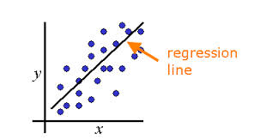
Introduction to Regression
Intuition
Simple
t-statistics
Making Predictions
Correlation
R²

Slide 18
What is regression?
Dependence of one variable (DV) on one or more explanatory or independent variables (IVs).
Types of relationships
Correlation
Causal
The technique is …
Often referred to as fitting a line to the data
Used to calibrate a statistical model
Widely used for solving business problems
Notes:
Involves the study of the dependence of one variable, the dependent variable, on one or more other variables, the explanatory or independent variables.
Types of relationships
Correlation
Causal
Most widely used technique for solving business problems
Statistical technique to calibrate a model
Often referred to as fitting a line to the data

Slide 19
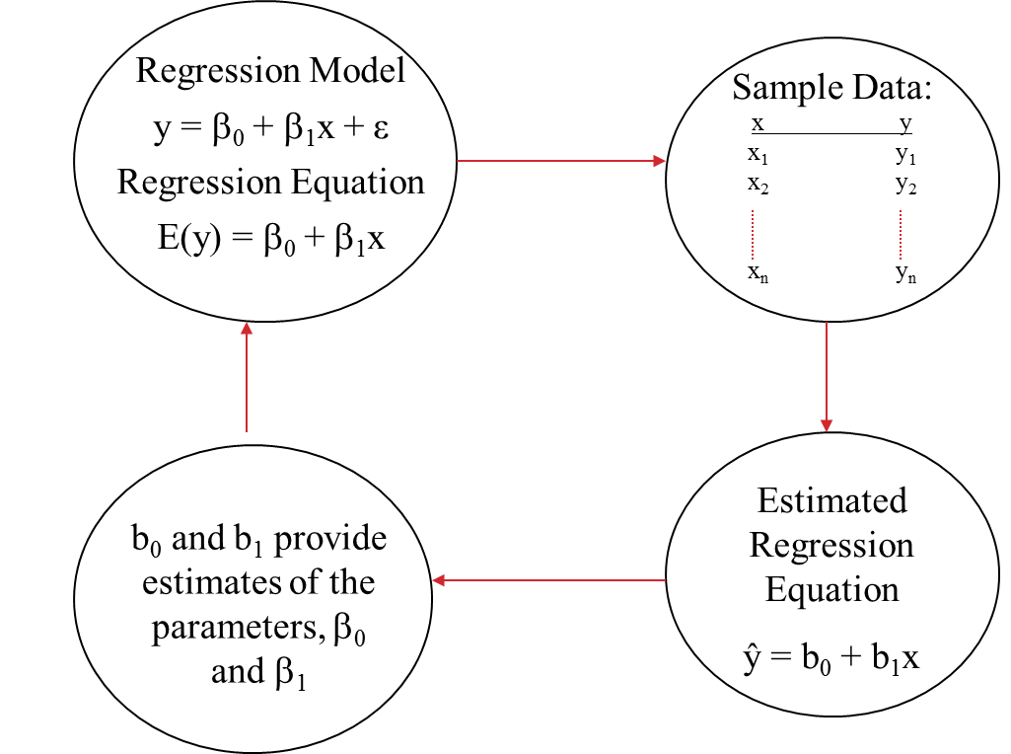
Process for Simple Regression
Notes:
This slide highlights the terminology and process for simple regression.
The outputs from the regression (b₁ and b₀) are estimates of the population parameters (β₀ and β₁).

Slide 20
Let’s get started…
We want to develop an equation to predict sales.
OPEN the data set Advertising.sav
What is your first, best guess at the predicted value of the DV?
How accurate is this prediction?
What variable is the dependent variable? Why?

Slide 21
Example: Advertising Data
Time period | sales
1 | 22.1
2 | 10.4
3 | 9.3
4 | 18.5
5 | 12.9
6 | 7.2
7 | 11.8
8 | 13.2
9 | 4.8
10 | 10.6
11 | 8.6
12 | 17.4
13 | 9.2
14 | 9.7
15 | 19
16 | 22.4
17 | 12.5
. | .
. | .
200 | 13.4
Notes:
These data are shown on the data sheet of Advertising Data.xlsx.

Slide 22
Questions to Be Answered
Management wants to develop an equation to predict sales.
What is your first, best guess at the predicted value of the DV?
How accurate is this prediction?
What variable is the dependent variable (DV)? Why?

Slide 23
Generate a correlation matrix to answer questions
Is there a relationship between advertising budget and Sales?
How strong is the relationship?
Analyse ➔ correlate➔ Bivariate➔ insert all variables to generate table.

Slide 24
What next?
Which column should we look at most closely?
Which variable has highest correlation with the dependent variable?
Why is this the best candidate for improving our prediction?

Slide 25
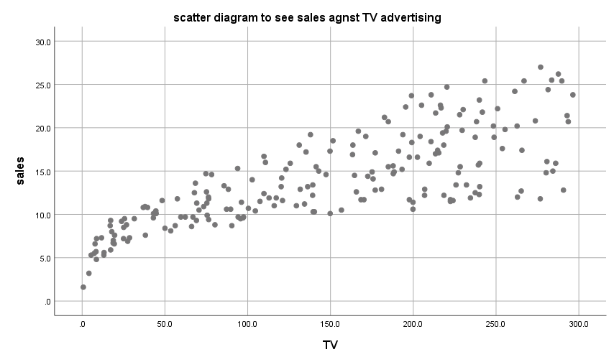
Consider sales with TV advertising. Is this what we expected?

Slide 26
Graphical Form
Ŷ= intercept + (slope)*X
Ŷ= b₀ + (b₁)*X
Sales
Slope = b₁
Intercept = b₀
1 Unit of Prev. Adv. (£1,000)
Prev. Adv.

Slide 27
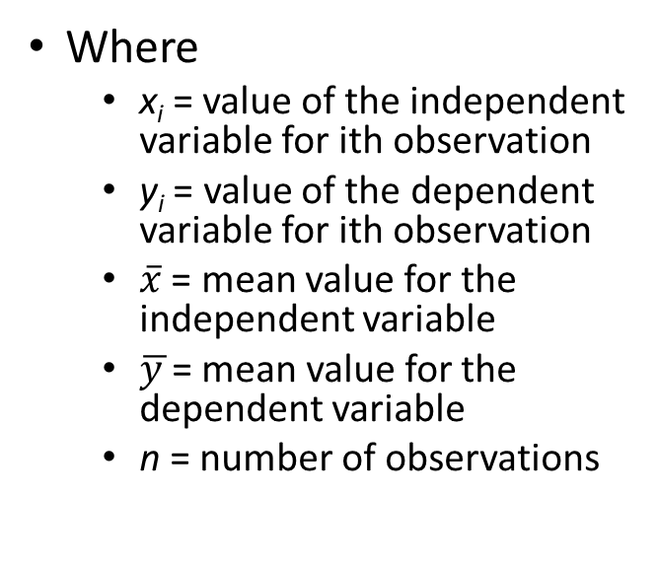
Slope & Intercept Equations
Where
x_{i} = value of the independent variable for ith observation
y_{i} = value of the dependent variable for ith observation
$\overline{x}$ = mean value for the independent variable
$\overline{y }$= mean value for the dependent variable
n = number of observations
Notes:
Note that b₁ is based on actual and mean values of x and y.
b₀ is a balancing value that anchors the line onto the vertical axis.
Without this value a line with the slope (b₁) could be any where on the plane.

Slide 28
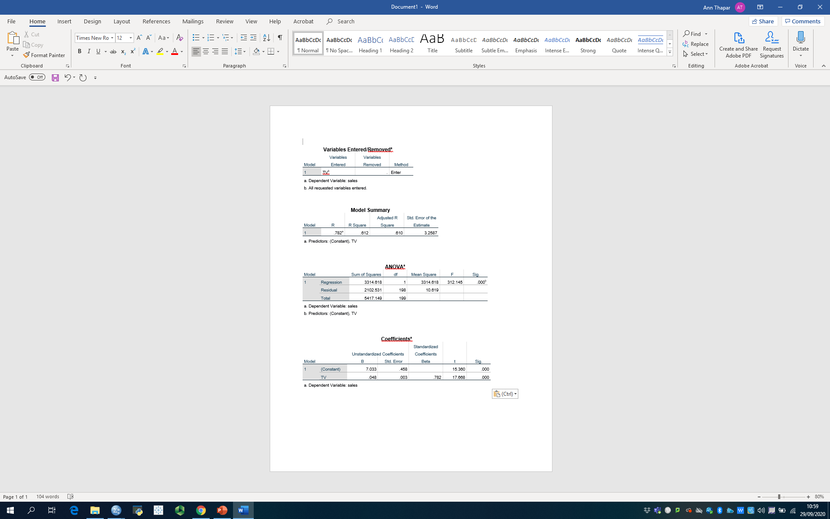
Linear model of sales vs TV ads

Slide 29
Graphical Form Insert figures from output for slope and intercept.
Ŷ= intercept + (slope)*x
Sales
Slope = 0.048
Intercept = 7.033
1 Unit of TV. Adv. (£1,000)

Slide 30
Verbal Form
Where
b₀ = 7.033
b₁= 0.048
$48
Change in Sales Associated with a Unit change in TV Advertising
$7033
Level of Sales w/o TV Advertising
Units of TV Advertising
Predicted Sales
=
*
+

Slide 31

Making Predictions
The equation:
$\hat{\text{Y}} \text{=}\text{ 7.033 }\text{+} \text{(}\text{0.048}\text{∗}\text{x}\text{)}$
What is predicted level of sales?
if X = 0?
if X = 10?
if X = 25?
Answers:

Slide 32
Predicting Sales w/ Equation
No | Sales | TV Adv. | Pred. Sales
1 | 22.1 | 230.1 | 18
2 | 10.4 | 44.5 | 9.1
3 | 9.3 | 17.2 | 7.9
4 | 18.5 | 151.5 | 14.2
5 | 12.9 | 180.8 | 15.6
6 | 7.2 | 8.7 | 7.4
7 | 11.8 | 57.5 | 9.8
8 | 13.2 | 120.2 | 12.7
9 | 4.8 | 8.6 | 7.4
10 | 10.6 | 199.8 | 16.5
: | : | : | :
200
Open “Reg Error” worksheet
Time period
Sales
TV Adv.
Calculate Pred. Sales
Use TV Adv. Data
Use the regression equation
Notes:
D2 = Sheet3!$B$17+(Sheet3!$B$18*C2)
‘Sheet3!’ identifies the sheet where regression output is located
$B$17 and $B$18 are the cells on the regression worksheet where the coefficients are located
Be sure to include the ‘$’ signs so that when the formula is copied these cells don’t change

Slide 33
Actual vs. Predicted Values

Slide 34
Are these Predictions Better?
Create Error column
Sales – Pred Sales
Sum errors
Create Error Squared column
Square each error
Sum the squared errors
How does this sum compare to the sum of squared errors from the baseline prediction?
 | Sales | TV Ads | PRED Sales | Error | Error Sq'd
1 | 22.1 | 230.1 | 18 | 4.1 | 16.81
2 | 10.4 | 44.5 | 9.1 | 1.3 | 1.69
3 | 9.3 | 17.2 | 7.9 | 1.4 | 1.96
4 | 18.5 | 151.5 | 14.2 | 4.3 | 18.49
5 | 12.9 | 180.8 | 15.6 | -2.7 | 7.29
6 | 7.2 | 8.7 | 7.4 | -0.2 | 0.04
7 | 11.8 | 57.5 | 9.8 | 2 | 4.00
8 | 13.2 | 120.2 | 12.7 | 0.5 | 0.25
9 | 4.8 | 8.6 | 7.4 | -2.6 | 6.76
10 | 10.6 | 199.8 | 16.5 | -5.9 | 34.81
. | . | . | . | . | .
. | . | . | . | . | .
200 | 13.4 | 232.1 | 18.1 | -4.7 | 22.09
Total |  |  |  | 0.1 | 2101.95
Notes:
Error = Actual Sales – Predicted Sales = B2 – D2
Error Squared = E2^2
Create sum of the columns E and F in Row 21

Slide 35
Assessing Prediction Accuracy
Total Sum of Squares (TSS)
Errors from Baseline
Sum of Squares Error or Residual (SSE)
Actual vs. Regression Predictions
Sum of Squares Regression (SSR)
Improvement due to the regression
Where:
= Average of all observations
= Predicted value of observation i using regression equation
= Actual value of observation i

Slide 36
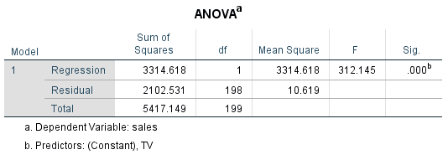
Assessing Prediction Accuracy
TSS = SSE + SSR
5417.149 = 2102.531 + 3314.618
Can you find these numbers on the regression output?

Slide 37
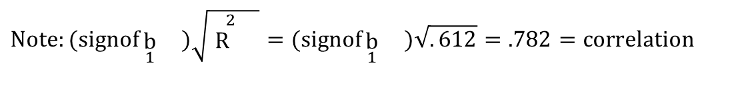
Coefficient of Determination – R²
Sum of Squares Regression (SSR)
R² =
Total Sum of Squares (TSS)
R² = SSR / TSS
= SSR / (SSR+ SSE) Since TSS = SSR + SSE
= 3314.618 /5417.149
= 0.612
Proportion of the total variation in the dependent variable explained by the independent variable of the regression equation
Range
Is Between 0 and 1
“Goodness of Fit”: Higher is better
$$Note:(signofb_{1}{})\sqrt{R^{ 2}{}}=(signofb_{1}{})\sqrt{. 612}=.782=correlation$$
Notes:
R = sq of rsq = 0.7 NOT ).*0. 894

Slide 38
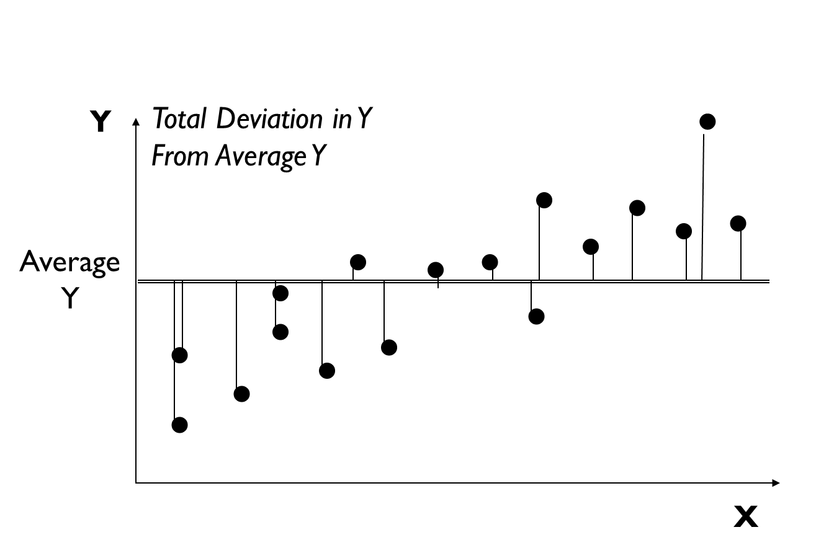
Regression Output – R²

Slide 39
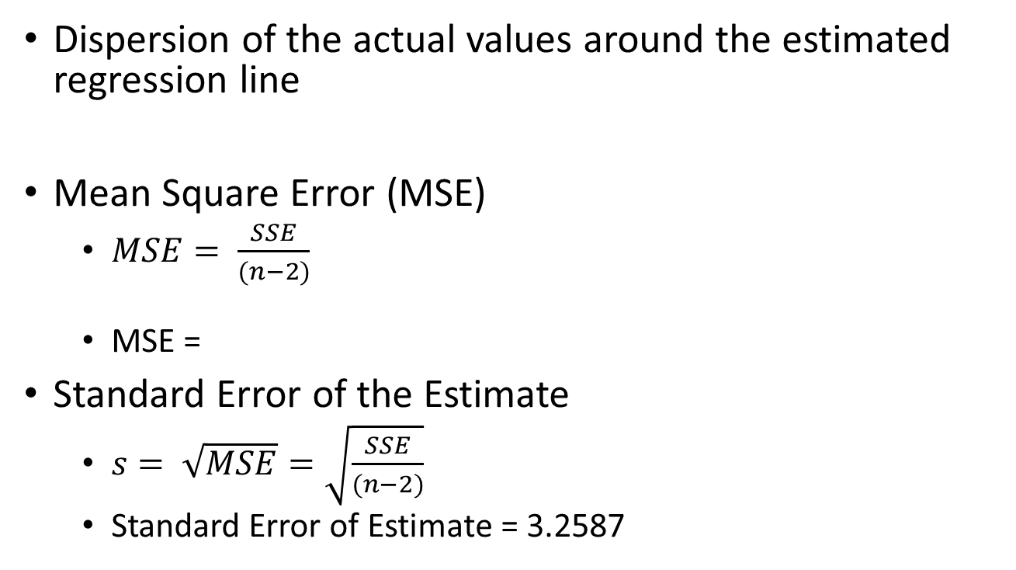
Standard Error of Estimate
Dispersion of the actual values around the estimated regression line
Mean Square Error (MSE)
$MSE= \frac{SSE}{(n−2)}$
MSE =
Standard Error of the Estimate
$s= \sqrt{MSE}=\sqrt{\frac{SSE}{(n−2)}}$
Standard Error of Estimate = 3.2587
n - Number of parameters estimated, b₀ and b₁
Notes:
The Mean Squared Error is intuitively similar to the variance
The variance is the dispersion around the mean, a point
The Mean Squared Error is the dispersion around the regression line
The Standard Error of the Estimate is intuitively similar to the standard deviation
It is the square root of the Mean Squared error
Just as the standard deviation is the square root of the variance

Slide 40
Multiple regression with the Advertising data to see if the model can be improved.
15 mins BREAK

Slide 41
7FNCE040W
Business Analytics
WEEK 3 BITE 3 cont

Slide 42
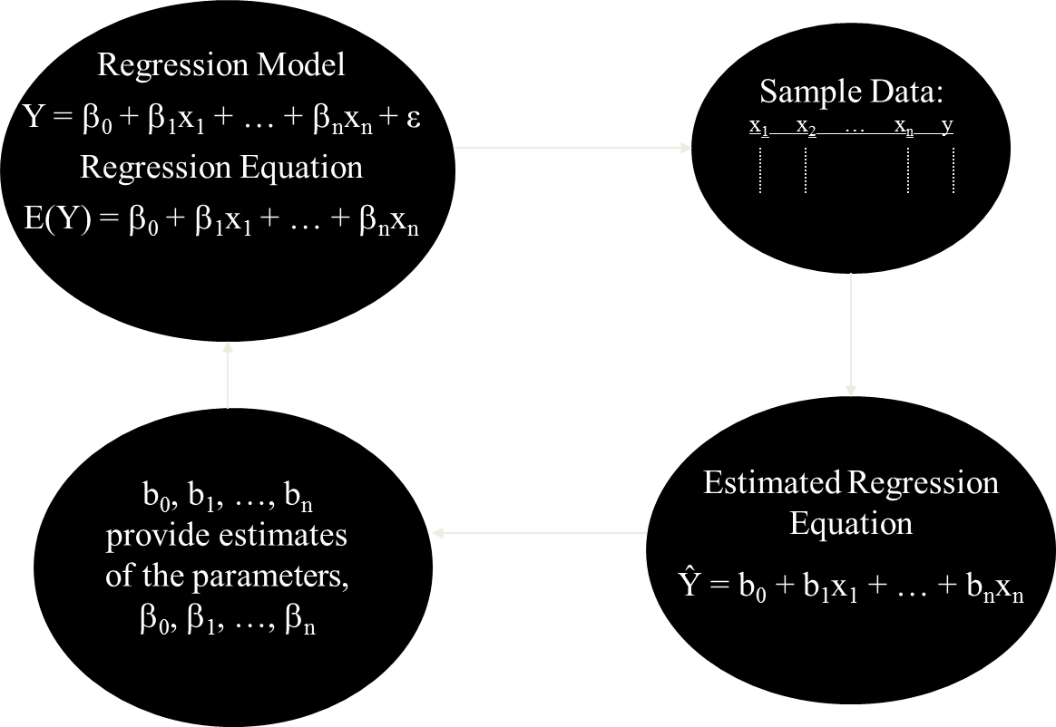
Continued.. Process for Multiple Regression
Notes:
The only change from what we had before is that we have more independent variables
Still only one dependent variable
Still want estimates of population parameters

Slide 43
Interpretation of the Coefficients
Ŷ = b₀ + b₁X₁ + b₂X₂ + … + b_{n}X_{n}
Interpretation
b₀
Expected value of Y when all X’s equal 0
Other slope parameters (b_{i}’s)
Change in Y when X_{i} changes by 1 unit
And “the other X’s remain constant”
This Extra Proviso very important
Estimates of b_{i}’s depend on which X’s are included
Notes:
b₀
Expected value of Y when all X’s equal 0
Sometimes this interpretation of b₀ does not make sense
Appropriate when all X_{i}’s=0 is possible
Can be an artifact of calculations – used to anchor line
Other slope parameters (b_{i}’s)
Change in Y when X_{i} changes by 1 unit
And “the other X’s remain constant”
This Extra Proviso very important
Estimates of b_{i}’s depend on which X’s are included

Slide 44
Open Advertising.sav in SPSS
1. Recreate Correlations Table
2. Recreate Simple Regression
Notes:
(1) Recreate Correlations Table
Analzye → Correlate → Bivariate
Select Sales, for all Variables
OK
(2) Recreate Simple Regression
Analyze
Regression → Linear
Specify Model w/ arrows
Dependent variable
Sales
Independent variable
TV ads
Method = Enter
OK

Slide 45
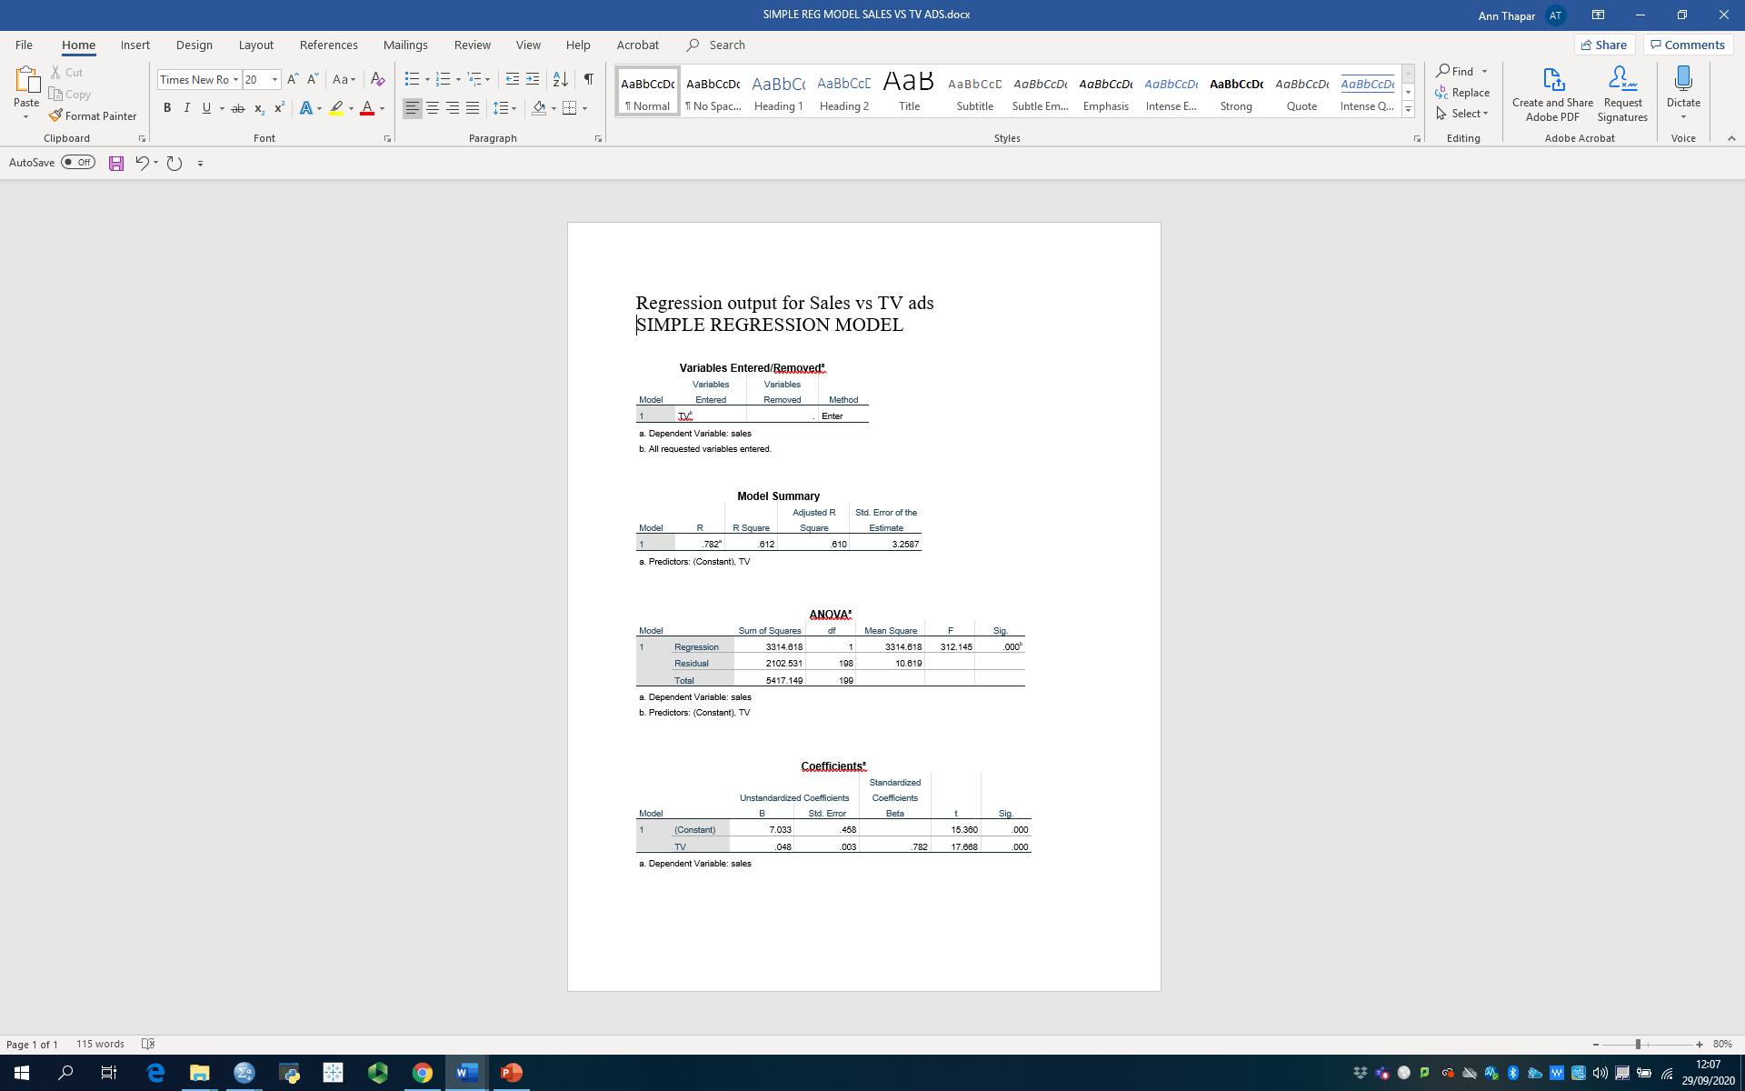
Viewing Output y = 0.0475x + 7.0326 R² = 0.6119
Correlation
R²
Std. Error of Estimate
TSS
SSE (Residual)
MSE
Estimates
b₀, b₁
Interpretation?
What to add next?
Note: p-value labelled Sig. in SPSS
Notes:
Parameter estimates in column labeled B
Intercept (b₀)
(Constant)
Interpretation: Sales when previous advertising = 0
Slope (b₁)
Previous Advertising
Interpretation: Change in sales when previous advertising changes by one unit

Slide 46
Add TV Advertising
Model Summary
Model | R | R Square | Adjusted R Square | Std. Error of the Estimate
1 | .947ª | .897 | .896 | 1.6814
a. Predictors: (Constant), radio, TV
ANOVAª
Model |  | Sum of Squares | df | Mean Square | F | Sig.
1 | Regression | 4860.235 | 2 | 2430.117 | 859.618 | .000^{b}
 | Residual | 556.914 | 197 | 2.827
 | Total | 5417.149 | 199
a. Dependent Variable: sales
b. Predictors: (Constant), radio, TV
Coefficientsª
Model |  | Unstandardized Coefficients |  | Standardized Coefficients | t | Sig.
 |  | B | Std. Error | Beta
1 | (Constant) | 2.921 | .294 |  | 9.919 | .000
 | TV | .046 | .001 | .753 | 32.909 | .000
 | radio | .188 | .008 | .535 | 23.382 | .000
a. Dependent Variable: sales
Notes:
Analyze
Regression → Linear
Specify Model w/ arrows
Dependent variable: Sales
Independent variables
TV
Radio
Method = Enter
OK

Slide 47
Statistics
Regression Output

Slide 48
R²
R² went from 0.612 (simple) to 0.897(multiple)
R² never decreases with more variables
Need a modified measure of R²
Indicates if an unhelpful variable is added
Accounts for
# Independent variables (including the intercept)
Sample size (N)
Notes:
R² never decreases with more variables
Even if the variable has little relationship with Y
Can be misleading when comparing regressions
Need a modified measure of R²
Indicates when an unhelpful variable is added
Accounts for
# Independent variables being estimates (including the intercept)
This is how large (or how many dimensions in) the previous table
Sample size (N)
How thinly we are spreading our data over the table from the previous slide

Slide 49
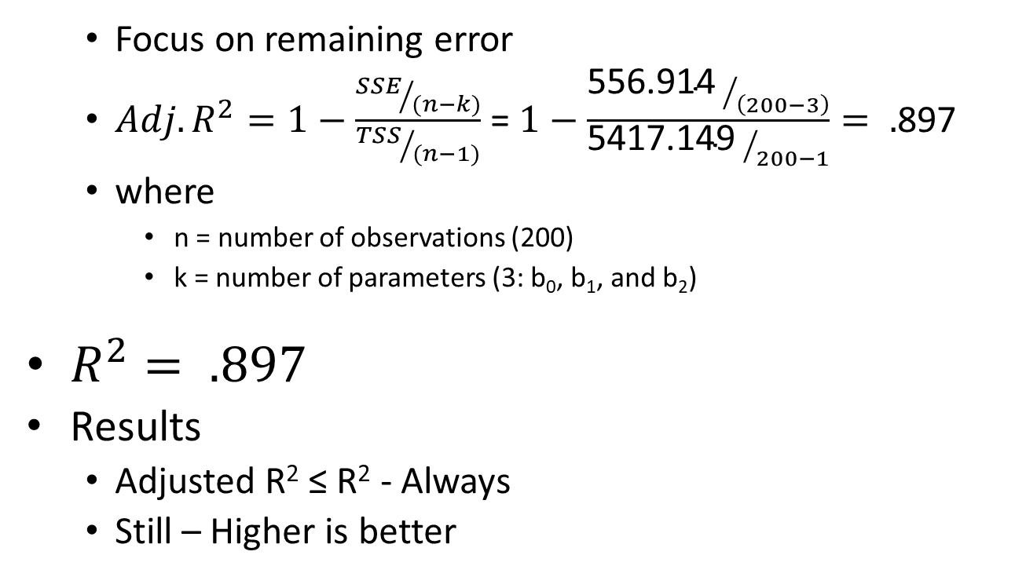
Accounting for N and Parameters Adjusted R²: Is this a good / better model?
Focus on remaining error
$Adj. R^{2}=1−\frac{{SSE}/{(n−k)}}{{TSS}/{(n−1)}}$ =$1−\frac{{\text{556.914 }}/{\left(200−3\right)}}{{\text{5417.149 }}/{200−1}}= .$897
where
n = number of observations (200)
k = number of parameters (3: b₀, b₁, and b₂)
$R^{2}= .897$
Results
Adjusted R² ≤ R² - Always
Still – Higher is better
Notes:
Based on the formula:
When an additional variable is added to the model, k increases by 1
If SSE stays the same (no additional explanatory power added by the variable)
The numerator increases
Since the denominator stays the same, the fraction increases
Subtracting this from 1, leads to a reduction in the Adjusted R²
Need a reduction in SSE that is sufficiently large to keep the numerator from increasing

Slide 50
R² Versus Adjusted R²
R²:
An additional variable will not decrease R²
Be wary of choosing a model because of a high R²
Adjusted R² : As the number of variables increases
The Adjusted R² is increasingly less than the R²
Adjusted R² can be negative
For comparing 2 models
Must compare models with same dependent variable
Many try to simply maximize Adjusted R²
Think about logical & theoretical relevance of variables
Adjusted R²
If High --- good
If Lower ---- not necessarily bad
R² went from .800 (simple regression) to .940
Adj. R² went from .788 (simple regression) to .933
Notes:
R²:
An additional variable will not decrease R²
Be wary of choosing a model because of a high R²
Adjusted R² : As the number of variables increases
The Adjusted R² is increasingly less than the R²
Adjusted R² can be negative
For comparing 2 models
Must compare models with same dependent variable
Many try to simply maximize Adjusted R²
Think about logical & theoretical relevance of variables
Adjusted R²
If High --- good
If Lower ---- not necessarily bad
R² went from ….. (simple regression) to …..
Adj. R² went from ……. (simple regression) to …….

Slide 51
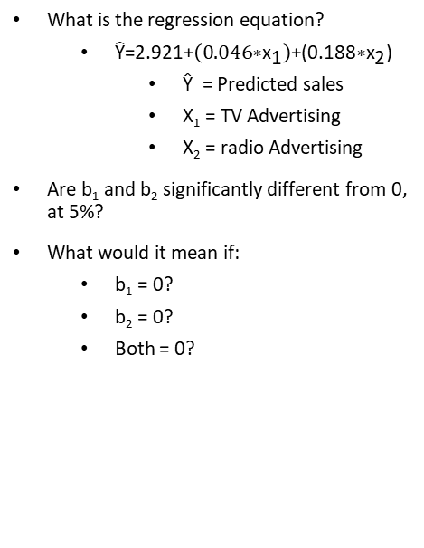
Regression Output - Coefficients
Coefficientsª
Model |  | Unstandardized Coefficients |  | Standardized Coefficients | t | Sig.
 |  | B | Std. Error | Beta
1 | (Constant) | 2.921 | .294 |  | 9.919 | .000
 | TV | .046 | .001 | .753 | 32.909 | .000
 | radio | .188 | .008 | .535 | 23.382 | .000
a. Dependent Variable: sales
What is the regression equation?
$\hat{\text{Y}}\text{=}\text{2.921}\text{+}\left(\text{0.046}\text{∗}{\text{x}}_{\text{1}}\right)\text{+(}\text{0.188}\text{∗}{\text{x}}_{\text{2}}\text{)}$
Ŷ = Predicted sales
X₁ = TV Advertising
X₂ = radio Advertising
Are b₁ and b₂ significantly different from 0, at 5%?
What would it mean if:
b₁ = 0?
b₂ = 0?
Both = 0?

Slide 52
The F-Statistic
ANOVAª
Model |  | Sum of Squares | df | Mean Square | F | Sig.
1 | Regression | 4860.235 | 2 | 2430.117 | 859.618 | .000^{b}
 | Residual | 556.914 | 197 | 2.827
 | Total | 5417.149 | 199
a. Dependent Variable: sales
b. Predictors: (Constant), radio, TV
Question: Is there something useful in the model?
Before accepting any model, F must be significant
H₀: b₁ = b₂ = … = b_{n} = 0
H₁: At least one b₁, b₂, … b_{n} ≠ 0
Is it significant at 5%?
No relationship between Ind. Vars. & Dep. Var.
At least 1 Ind. Var. helps explain the Dep. Var.
Notes:
H₀: No relationship between Ind. Vars. & Dep. Var.
H₁: At least 1 Ind. Var. helps explain the Dep. Var.
Used to determine if a relationship exists between the dependent variable and the set of independent variables
If sig. there is a relationship with at least one independent variable
Does not tell us which independent variable has the relationship
Before accept new model, F must be significant
Reject H₀?
Yes, if sig. < 0.05
No, if sig. > 0.05
Sig. = .000
Reject H₀
At least one variable (Adv or Prev Adv) is helpful in predicting sales

Slide 53

Quick Review
What is the difference between:
b₀, b₁, … b_{n} and β₀, β₁, … β_{n}?
What is the difference between:
$\hat{y_{i} } \text{and} \overline{y} \text{and} y_{i}$?
What is R²?
What is the difference between:
R² and Adjusted R²?
What is H₀ for:
F-statistic?
t-statistic?

Slide 54
Regression with TV Adv & Radio Adv
Is there something good in the model?
Is it better than the simple regression?
How do you interpret b₀, b₁ and b₂?
Are they significantly different from 0?

Slide 55
Model Summary
Model | R | R Square | Adjusted R Square | Std. Error of the Estimate
1 | .947ª | .897 | .896 | 1.6855
a. Predictors: (Constant), newspaper, TV, radio
ANOVAª
Model |  | Sum of Squares | df | Mean Square | F | Sig.
1 | Regression | 4860.323 | 3 | 1620.108 | 570.271 | .000^{b}
 | Residual | 556.825 | 196 | 2.841
 | Total | 5417.149 | 199
a. Dependent Variable: sales
b. Predictors: (Constant), newspaper, TV, radio
Coefficientsª
Model |  | Unstandardized Coefficients |  | Standardized Coefficients | t | Sig.
 |  | B | Std. Error | Beta
1 | (Constant) | 2.939 | .312 |  | 9.422 | .000
 | TV | .046 | .001 | .753 | 32.809 | .000
 | radio | .189 | .009 | .536 | 21.893 | .000
 | newspaper | -.001 | .006 | -.004 | -.177 | .860
a. Dependent Variable: sales

Slide 56
New Output
Is there something good in the model?
Yes
Based on F
Is it a better model?
Yes
Based on Adj. R²

Slide 57
Which regression is best?
 | Newest Variable
 | TV Adv. | Radio Adv. | Newspaper
Regression Sum of Squares
Error Sum of Squares
Total Sum of Squares
F (sig)
R²
Adjusted R²
Notes:
Total sum of squares (TSS) constant across all models
Regression sum of squares (SSR) increasing ⇒ R² increasing
Error sum of squares decreasing
F significant ⇒ There is something useful in each model
Adj. R² increasing ⇒ Each additional variable is helpful
See pages 151 – 152 of Dielman(2005) for a statistical F test to assess whether the improvement in a model is significant.

Slide 58
Which Variables Explain Y?
Ŷ = b₀ + b₁X₁ + b₂X₂ + b₃X₃
X₁ = TV
X₂ = Radio
X₃ = Newspapers
What does it mean if:
Reject H₀: b₁ = b₂ = b₃ = 0 based on F?
b₁ ≠ 0? and/or
b₂ ≠ 0? and/or
b₃ ≠ 0?
Which one?
Question: Is b_{i} significantly different from 0?
Notes:
If we rejected H₀: b₁ = b₂ = b₃ = 0 based on F then we know at least 1 bi ≠ 0.
Which one?

Slide 59
Output: t-statistics
t-test for single mean built in
For X₃ = population
H₀: b₃ = 0
H₁: b₃ ≠ 0
Do we reject H₀?
Yes, significantly different from 0 at 5%
This implies that the variable helps explain Y
Notes:
You cannot look at the size of the estimated parameter to see if it is different from 0.

Slide 60
Output: t-statistics
Coefficientsª
Model |  | Unstandardized Coefficients |  | Standardized Coefficients | t | Sig.
 |  | B | Std. Error | Beta
1 | (Constant) | 2.939 | .312 |  | 9.422 | .000
 | TV | .046 | .001 | .753 | 32.809 | .000
 | radio | .189 | .009 | .536 | 21.893 | .000
 | newspaper | -.001 | .006 | -.004 | -.177 | .860
a. Dependent Variable: sales
B for Population
Looks like a very small number
Question: Is it significantly different from 0?

Slide 61
Compare Coefficients
Coefficients | Newest Variable
 | TV | Radio | Newspaper
TV
Radio
Newspaper
New coefficients would change predictions
Very important to include correct variables
Why Extra Proviso is present

Slide 62
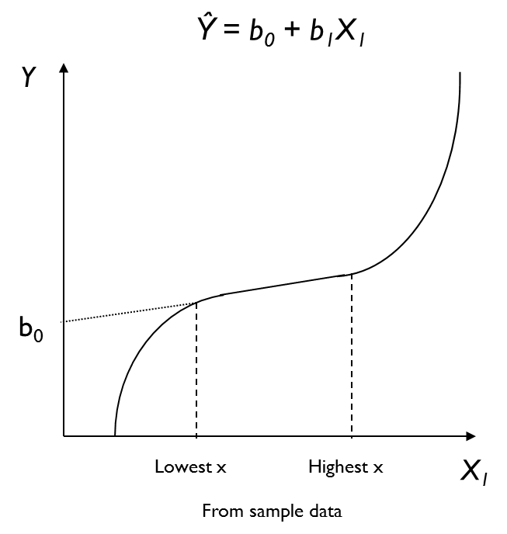
Caution: Interpreting Parameters
Intercept: b₀
In words?
Does this make sense?
Maybe – but we don’t know
This is the line we estimated
Notes:
Remember, b₀ is an anchor that places the line someplace in the plane.

Slide 63
Caution: Interpreting Parameters
Intercept: b₀
In words?
Does this make sense?
No – X₁ can not = 0
Slopes: b₁
Interpretation, in words?
If significant:
Does not mean a causal relationship exists
Does not mean entire relationship is linear
The equation applies
ONLY to this part
of the curve.
Notes:
What if the actual (true in population) relationship looked like this?
Intercept:
b₀
Estimate with all X_{i} = 0 may not be reasonable
Intercept
The predicted value of Y when all X_{i}’s = 0
Sometimes
An artifact of computations
All X_{i}’s = 0 is not a possibility

Slide 64
Predictions
Ŷ= 2.939+ 0.046(X₁) +0.189 (X₂) -0.001 (X₃)
Ŷ = Predicted sales
X₁ = TV Advertising
X₂ =Radio Advertising
X₃ = Newspaper Advertising
Substitute given values of x_{i} into the equation
Forecast from values from range of sample data
Focus on interpreting coefficients
Intercept not always sensible
Notes:
Substitute values of x_{i} from range of x_{i}’s used for estimating the model
Slope (b_{i})
Change in prediction of Y when X_{i} changes by 1 unit
And “the other X’s remain constant”
Cautions
Predictions are best with values from the range of explanatory variables (sample values)
Watch units when making comparisons:
Some may look small but be significant
Some may look large but not be significant
May want to re-estimate equation w/o insignificant variables – changes coefficients

Slide 65
In-Class/Extra Problem
Open Meddicorp.sav
Run the requested regressions & answer the questions
Be prepared to discuss your answers

Slide 66
Part 1: 1st Regression
Notes:
Place your output in this slide and save for later reference.

Slide 67
Part 2: 2nd Regression
Notes:
Place your output in this slide and save for later reference.

Slide 68
Next Week
Topics
Chapter 3 & 4
More on Multiple Regression
Readings

